Slide 1


183 DB Weekly Report
Week2 Team Parsley
Lin Li, Amir Omidfar, Wilson Chang, Angel Jimenez

Slide 2
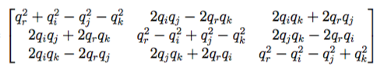
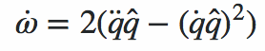
Unit Quaternion
Only one representation for orientation
Rotation matrix does not contain trigonometric functions
Cleaner expression for angular acceleration
Avoid gimbal lock problem

Slide 3
Mathematical Derivation for DC motor
Stepper Motor
Full torque
Higher energy cost
Higher speed
Acceleration & power
Servo Motor
Torque control
Lower energy cost
Lower Speed
Length
Torque & Inertia
Size
Rocket vs drone
Smal electric DC motor
Permanent Magnet DC motor
Good starting torque
Good speed regulation
Series Motor
high start torque
Speed: high- light load
Shunt Motor
Const speed
Low start torque
Compound motor
Benefits of shunt and series
Motor Drift...

Slide 4
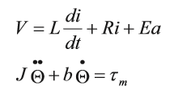
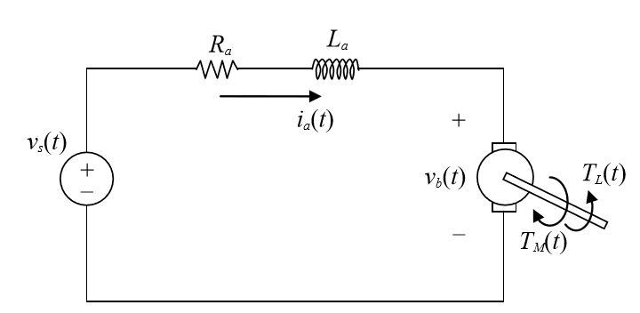
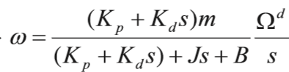
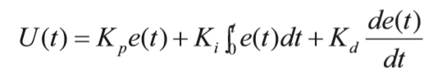
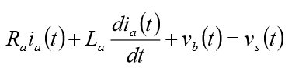
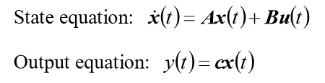
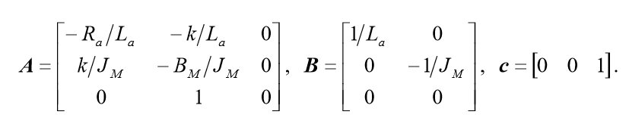
Mathematical Derivation for DC motor
Speed control vs State Space Estimation

Slide 5
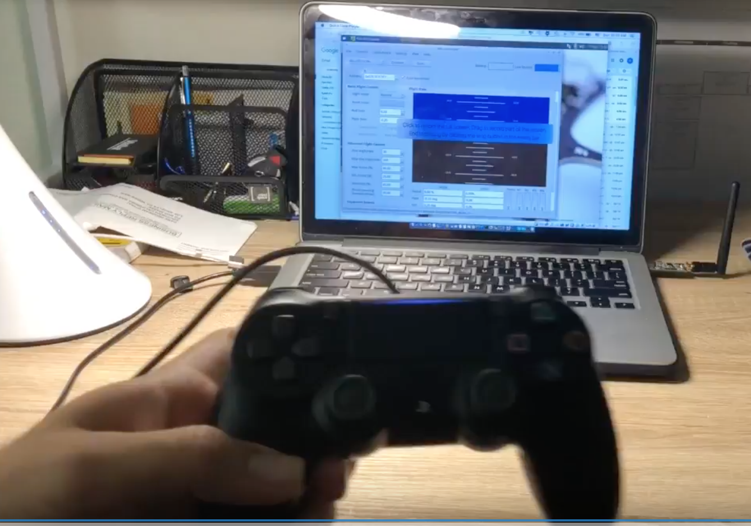
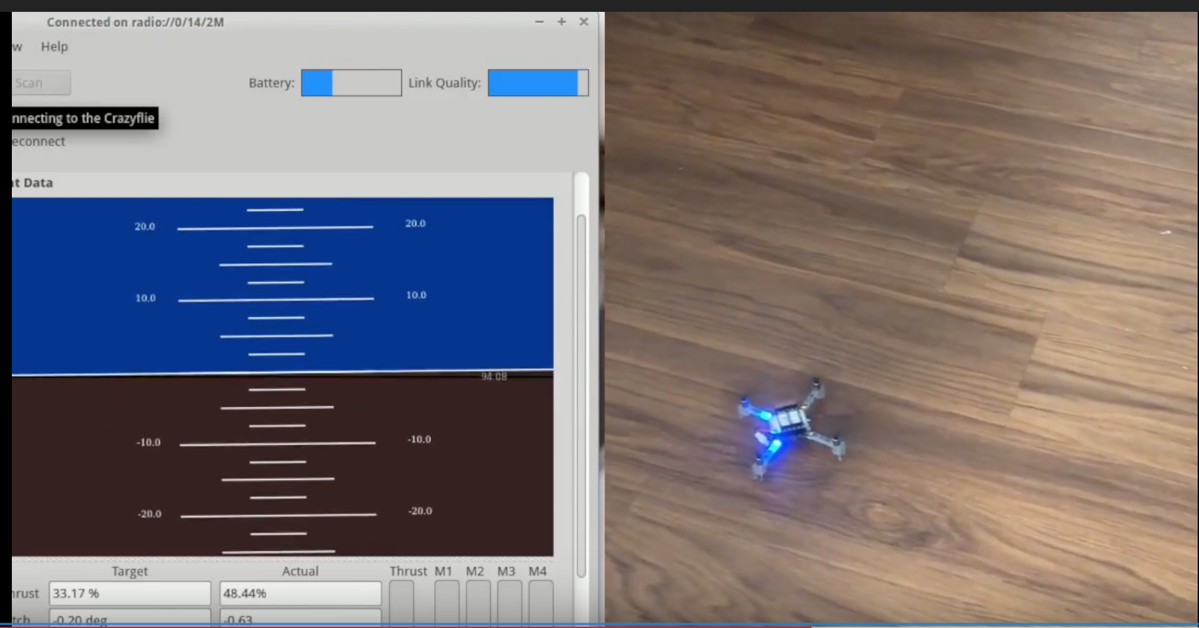
Hack the Drone controller
(use ps4 controller for driving the drone)
Demo on controlling the drone with PS4 controller:
https://youtu.be/i5cuPygJWJk
Notes:
Show the resources to :
use/control/program the drone
Being able to work with the drone

Slide 6
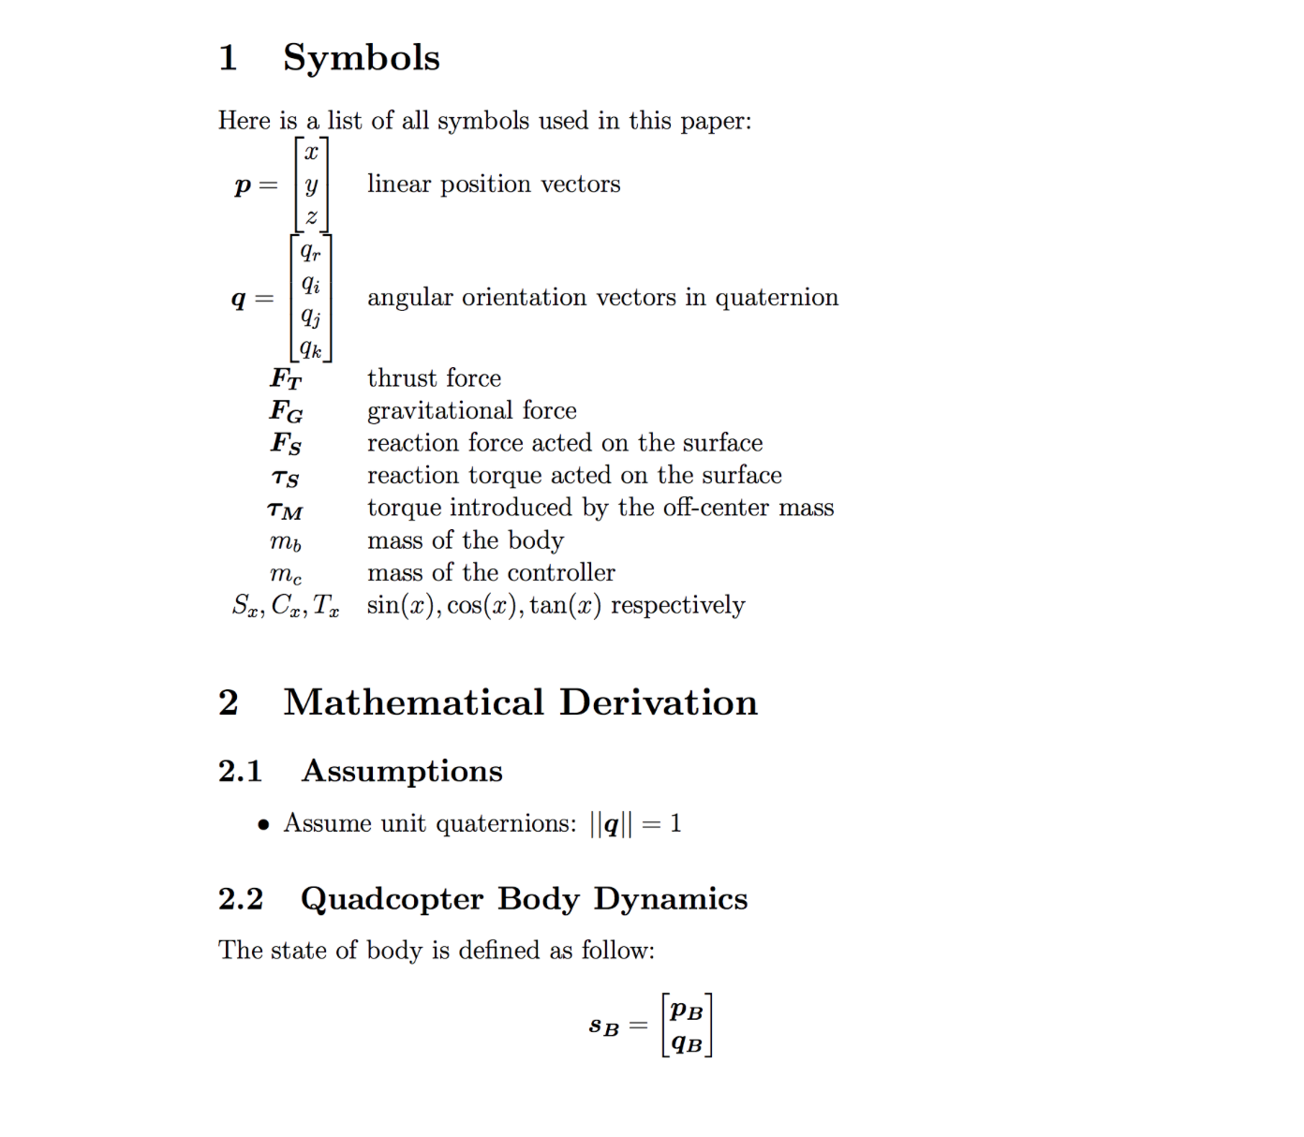
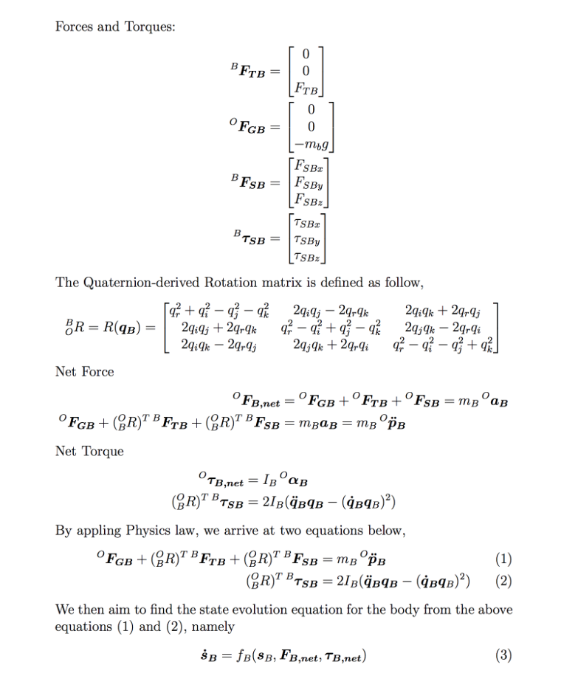
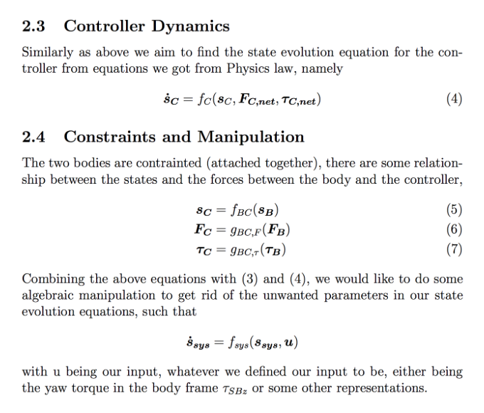
Documentation

Slide 7
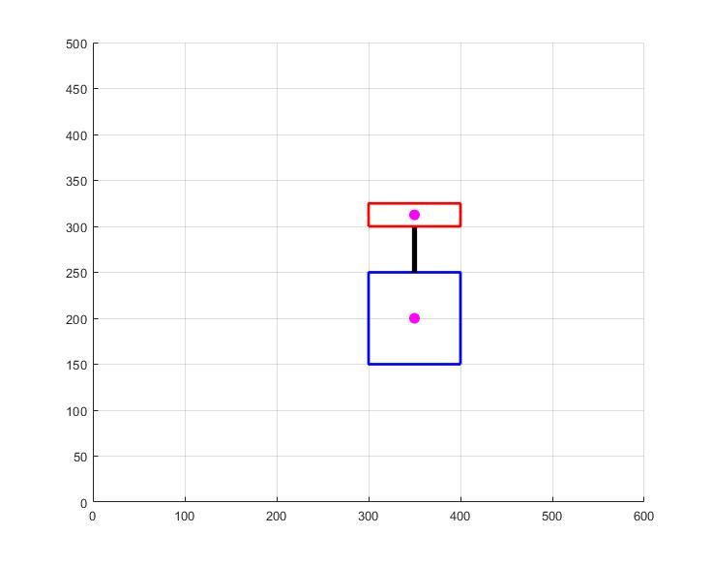
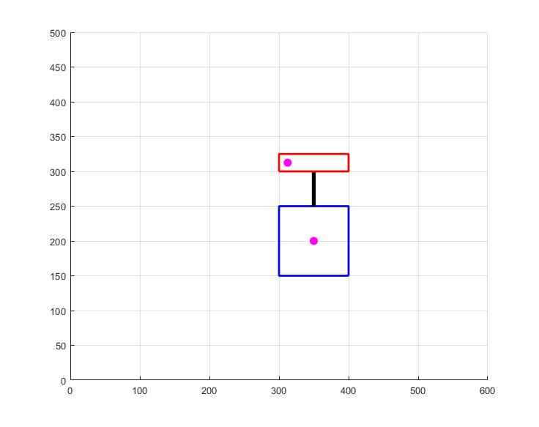
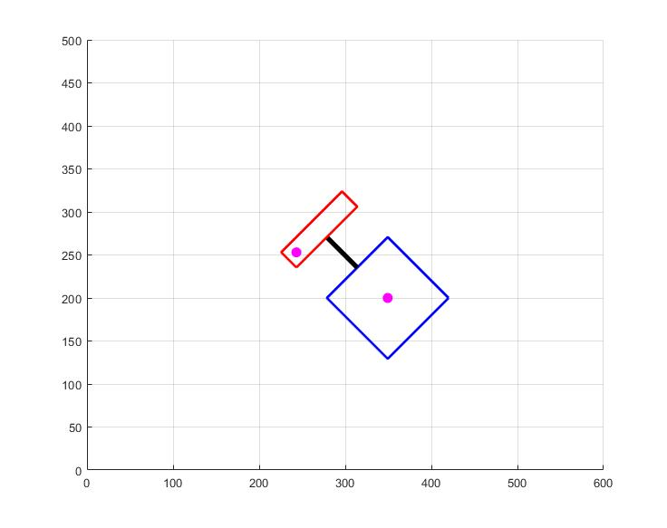
Next Week Planning
Perform simulation based on our mathematical model ( Lin,Amir )
Find the proper material to be used for the off center spinning mass and start building the prototype (Amir)
Keep track of our progress, updating our report document (Everyone)

Slide 8
References
T. Luukkonen, “Modelling and control of quadcopter,” Aalto School of Science, Aug. 2011.
https://www.electronics-tutorials.ws/io/io_7.html
https://www.amci.com/industrial-automation-resources/plc-automation-tutorials/stepper-vs-servo/

